Slide 1

B2B Portals
S.MAHAMMAD SHAREEF
192011229
B.TECH.CSE(3 r̥ḍ YEAR)
Subject:CSA3723-Software Testing for Test Case Design

Slide 2

AIM:
TO VERIFY AND VALIDATION THE B2B portals .

Slide 3
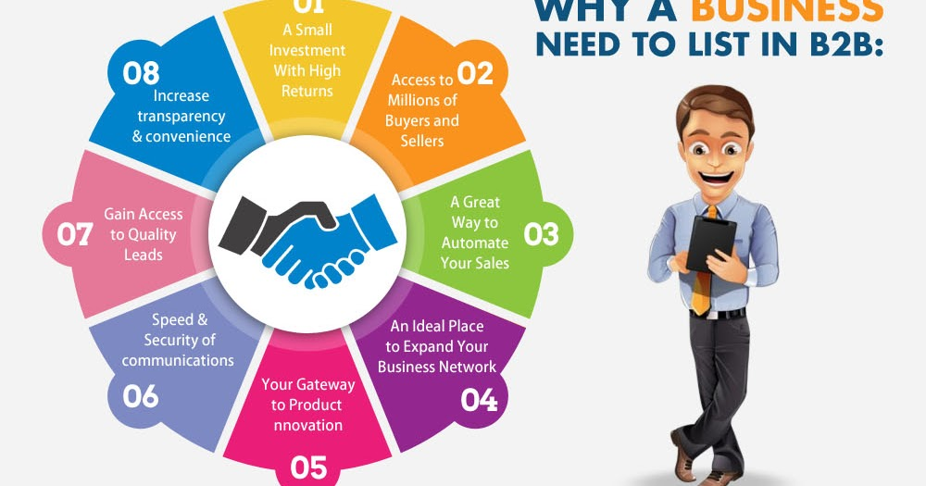

Slide 4
REQUIREMENTS:
USER ID AND PASSWORD
BANK ACCOUNT
E BANK
NETWORK FACILITIES

Slide 5
TEST CASE SCENARIO:
CAN THE USER LOGIN WITH A VALID EMAIL ID AND PASSWORD?
TO VERIFY THE PIN IS VALID OR NOT
CAN THE USER CHECK BALANCE OF OUR BANK ACCOUNT OR NOT
TO CHECK THE USER GO CORRECT FOR BANK TO BANK TRANSFER BETWEEN COMPANIES OR NOT
CAN THE USER ENTERED VALID ACCOUNT NUMBER FOR THE TRANSFER
CAN USER ENTERED THE MAXIMUM AMOUNT OF TRANSFER
CAN THE USER ENTERED WITH A UPI ID.
TO VERIFY THE USER FINISH THE FINAL PROCESS FOR FUND TRANSFER.
CAN THE USER CHECK THE PAYMENT MODE AND ORDER DETAILS.

Slide 6
POSITIVE SCENARIO:
CAN THE USER ENTERED A VALID USER ID AND PASSWORD
TO VERIFY THE MTPIN IS VALID
CAN THE USER CHECKS A BANK BALANCE
CAN THE USER ENTERED CORRECT OPTION FOR FUND TRANSFER
TO VERIFY THE USER ENTER VALID ACCOUNT NUMBER
CAN THE USER ADD VALID BENEFICARY ACCOUNT
CAN THE USER ENTERED VALID UPI ID
TO CHECK BANK BALANACE WITH VALID ACCOUNT.

Slide 7
NEGATIVE SCENARIO:
WHAT HAPPENED WHEN THE USER ENTERED INVALID ID AND PASS
FORGOT PASSWORD ,OPTION NOT WORKING.
WHAT HAPPEN WHEN USER ENTERED VALID ID AND INVALID PASS
CAN USER ENTERED THE INVALID MTPIN
TO VERIFY USER ENTERS THE WRONG OPTION FOR TRANSFER
CAN THE USER ENTERED INVALID BENFICIARY ACCOUNT
TO VERIY USER ENTERS THE WRONG OPTION FOR TRANSFER
CAN USER ENTERED INVALID MAXIMUM AMOUNT
CAN THE USER ENTERED INVALID BENEFICIARY ACCOUNT
WHAT HAPPEN WHEN THE USER enter details.

Slide 8
TEST CASES:
CAN THE USER ENTERED VALID USER ID AND PASS=POSITIVE
WHAT HAPPENED WHEN THE USER ENTERED INVALID MTPIN =NEGATIVE
CAN THE USER ENTERED VALID BENEFICIARY ACCOUNT=POSITIVE
WHAT HAPPENED WHEN THE USER ENTERED INVALID UPI PIN= NEGATIVE
CAN THE USER ENTERED A VALID AMOUNT TO TRANSFER=POSITIVE

Slide 9
TEST CASES:
TEST CASES
TYPE –NEGATIVE/POSITIVE
Positive
Negative
Positive
Positive
Positive
Verify if a user will be able to login with valid user name and valid password.
Verify if a user cannot login with a valid username and invalid password.
Verify the forget password functionality.
Verify the remember me functionality.
Verify if user is able to login with a new password only after he /she has changed password.

Slide 10
THANK YOU

